Slide 1
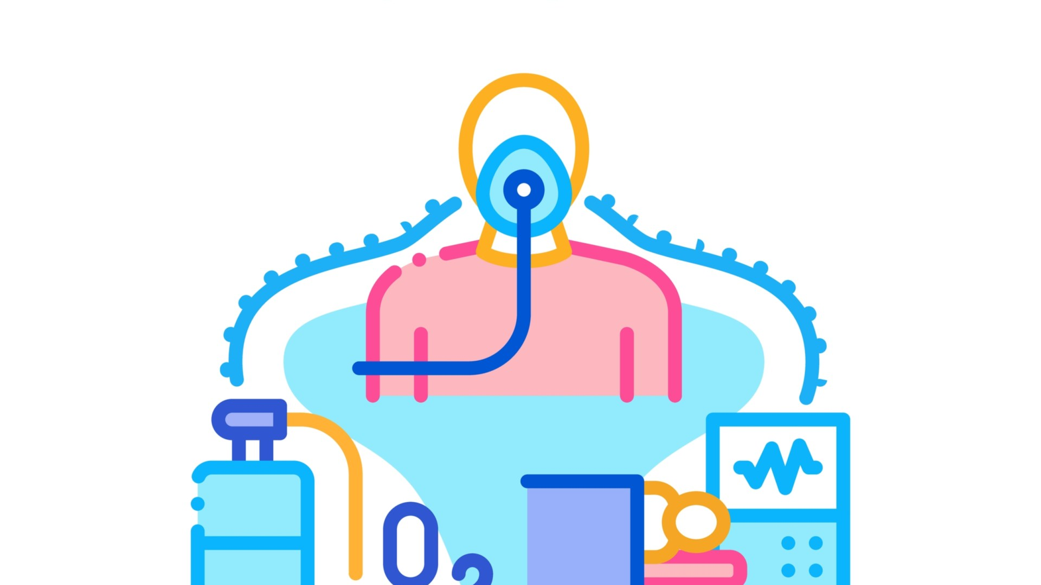
THỰC HÀNH MÔ PHỎNG TIẾP CẬN BỆNH NHÂN SUY HÔ HẤP
Ths.bs nguyễn bích trăm
ICU D11 HOSPITAL

Slide 2
CONTENTS
1. OVERVIEW
2. INDICATION
3. OXYGEN DELIVERY DEVICES
4. OXYGEN TOXICITY
5. CLINICAL APPROACH

Slide 3
Overview
Oxygen is the most commonly used drug in emergency medicine
34% of ambulance patients receive oxygen during transit
15–17% of hospital inpatients will be receiving oxygen at any given time [1, 2]
Oxygen is a treatment for hypoxaemia not breathlessness.
Oxygen is a drug and should be prescribed with a target saturation range
Notes:
Dyspnoea can occur for many reasons other than cardiorespiratory disease, including metabolic acidosis, anxiety and pain, and treatment with oxygen is not indicated in these cases
Hyperoxaemia can cause coronary vasoconstriction

Slide 4
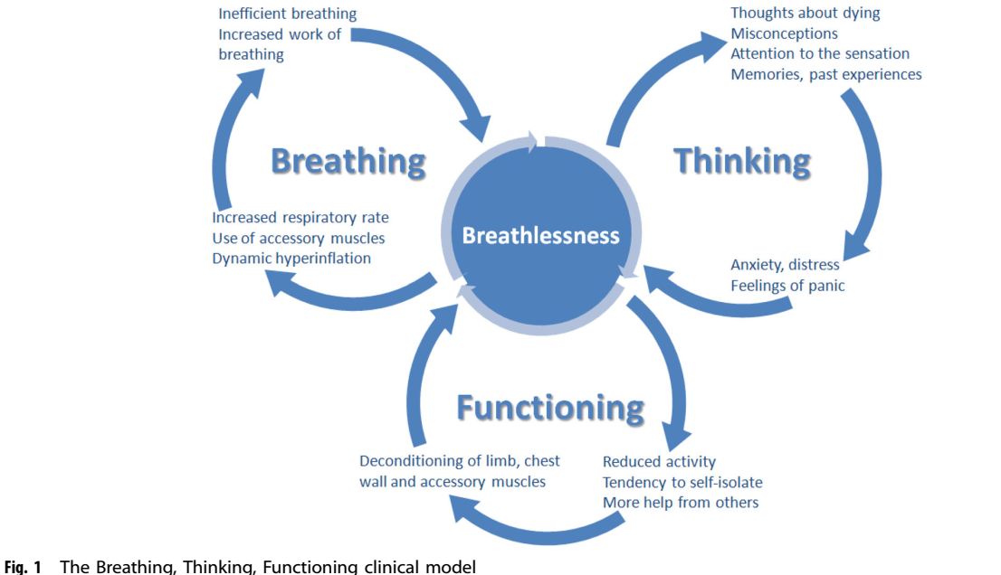

Slide 5
Indications
Correct documented or suspected acute hypoxemia (Increase alveolar and blood levels of O2)
Decrease symptoms associated with chronic hypoxemia
Decrease the workload hypoxemia imposes on the cardiopulmonary system o Able to achieve acceptable arterial oxygenation only by increasing ventilation o Able to maintain acceptable tissue oxygenation only by increasing cardiac output o Pulmonary vasoconstriction and hypertension increase workload on the right side of the heart

Slide 6
Need for oxygen therapy
Clinical condition: carbon monoxide or cyanide poisoning, shock, trauma, or acute myocardial infarction, …
Manifestations: tachypnea, tachycardia, cyanosis, hypertension, distressed overall appearance, somnolence, confusion
Laboratory measures: o PaO2 less than 60 mm Hg or SaO2 less than 90% in subjects breathing room air o PaO2 or SaO2 below desirable range for a specific clinical situation

Slide 7
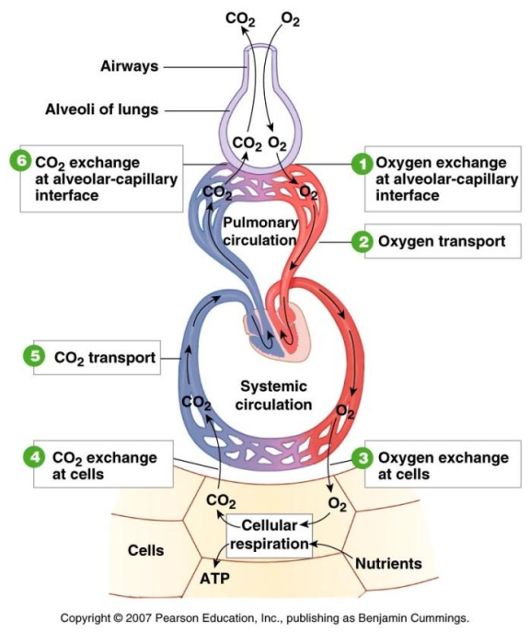
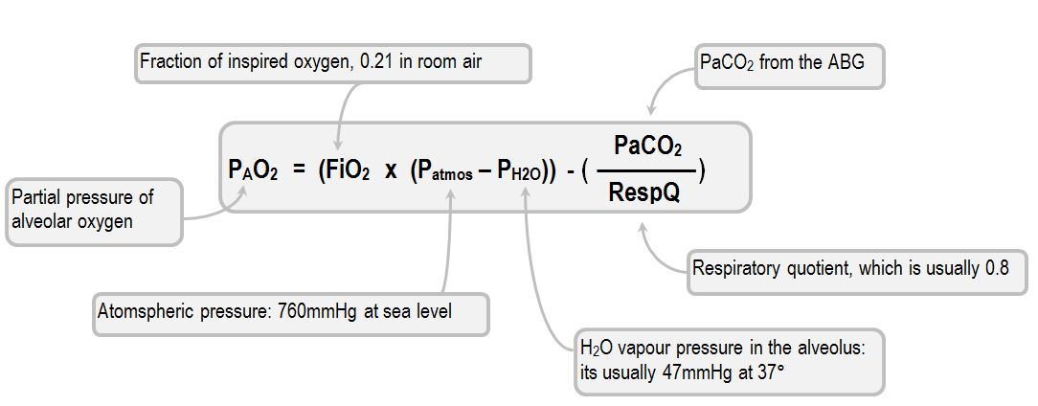

Slide 8
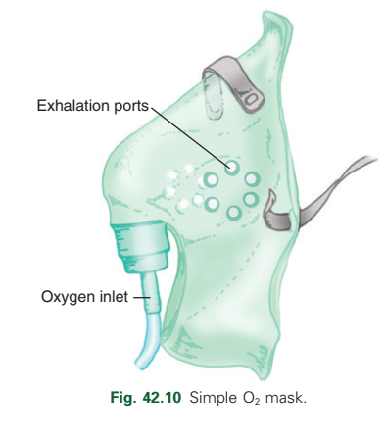
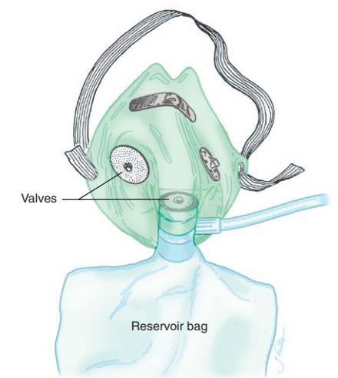
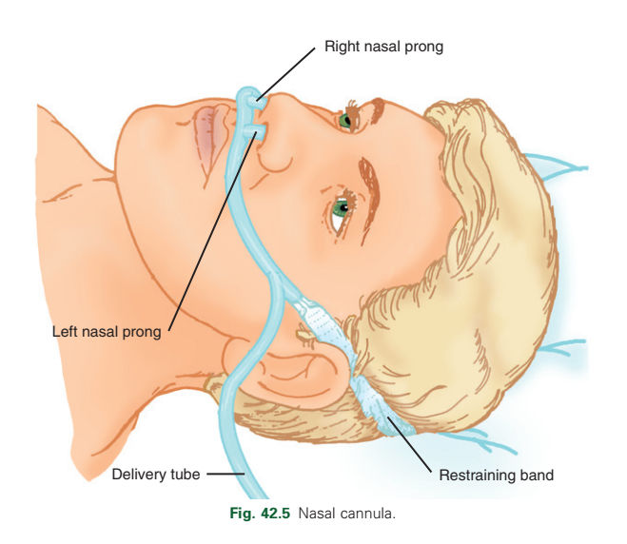
OXYGEN DELIVERY DEVICES Nasal prong, Simple mask, Reservoir mask

Slide 9
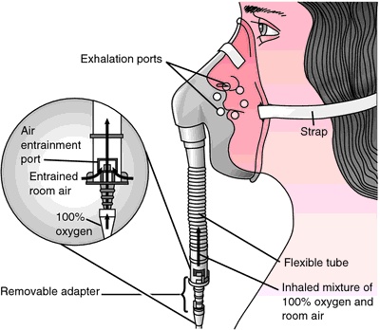
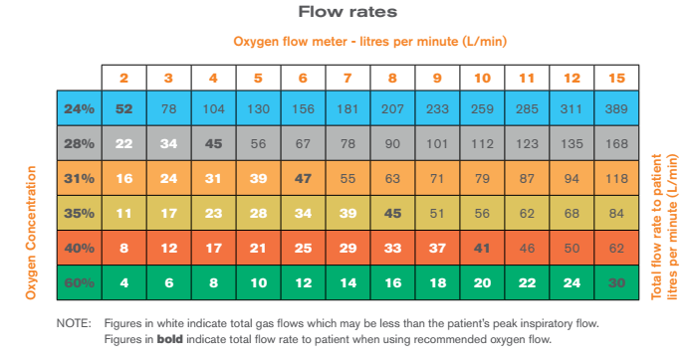
Venturi mask
OXYGEN DELIVERY DEVICES

Slide 10
OXYGEN DELIVERY DEVICES High Flow Nasal Cannula (HFNC)

Slide 11
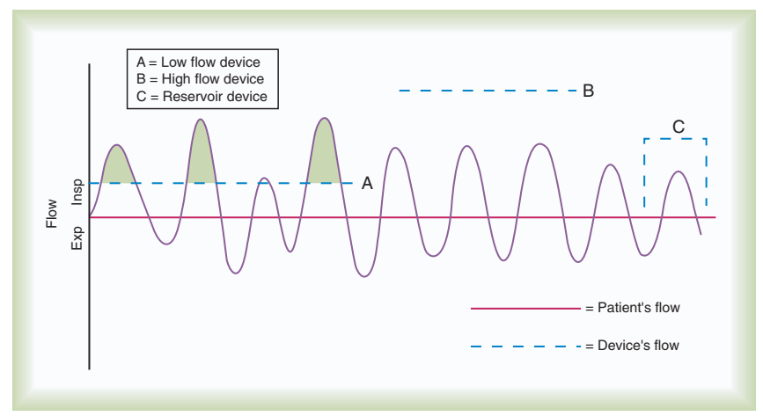
Differences Between O2 Delivery Systems
Notes:
The user judges the performance of an O2 delivery system by answering two key questions:
How much O2 can the system deliver (FiO2 or FiO2 range)?
(2) Does the delivered FiO2 remain fixed or vary under changing patient demands? A flow of 8 L/min or less

Slide 12
EFFECTIVE FIO2

Slide 14
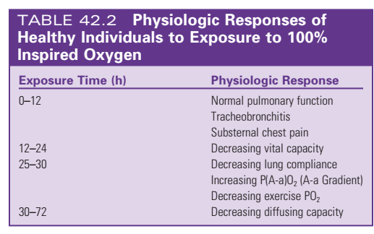
Oxygen toxicity
Notes:
In the presence of high PaO2, free radicals can overwhelm the body’s normal antioxidant system and cause cell damage. Cell damage provokes an immune response and causes tissue infiltration by neutrophils and macrophages. These scavenger cells release inflammatory mediators that worsen the initial injury. At the same time, local neutrophils and platelets may release more free radicals, which continue the process

Slide 15
Oxygen toxicity
Notes:
Hyperoxia has been defined by several studies as a PaO2 greater than 300 mm Hg
These studies demonstrate hyperoxia induced vasoconstriction, decreased cardiac output, and decreased perfusion to the brain, heart, and skeletal muscles.
The threshold appears clinically important at a PaO2 of greater than 150 mm Hg

Slide 16
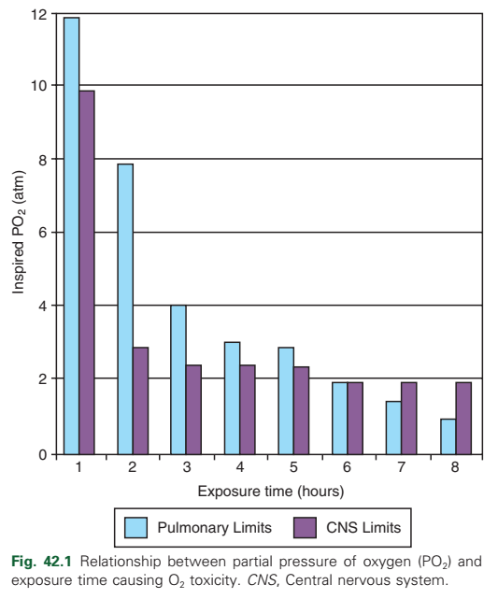
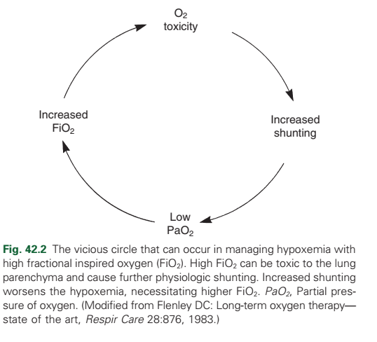

Slide 17
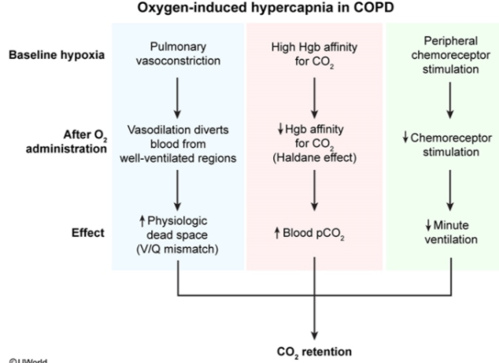
Oxygen-induced hypercapnia in COPD
Notes:
Giảm thông khí
Gắn vào Hb → đẩy CO2 ra ngoài
Rối loạn thông khí tưới máu
One theory on why this small group of COPD patients hypoventilate is that O2 administration and the resulting increase in arterial oxygen levels cause suppression of the hypoxic drive. In this subset of COPD patients, the normal response to increase ventilation in the presence of high partial pressure of carbon dioxide (PaCO2) is blunted and the primary stimulus to breathe becomes lack of O2 as sensed by the peripheral chemoreceptors. The increase in the blood O2 level in these patients suppresses peripheral chemoreceptors, depresses ventilatory drive, and elevates the PaCO2.16,17 It is further suspected that high blood O2 levels in such patients may also disrupt the normal ventilation/ perfusion balance and cause an increase in dead space–to–tidal volume ratio (VD/VT) and in PaCO2.

Slide 18
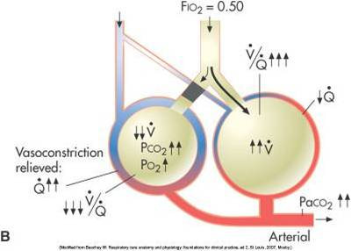
Oxygen-induced Hypercapnia COPD

Slide 22
Notes:
Any alteration in oxygen therapy should be reassessed in 30–60 min by repeat ABG

Slide 23
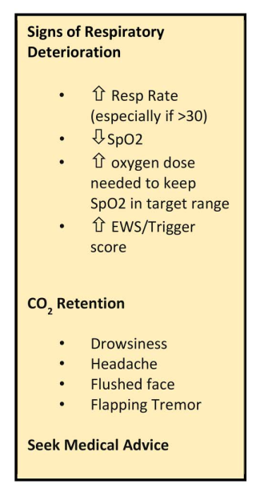
FAILURE
Notes:
Điểm cảnh báo xấu đi
Diễn tiến distress sang suy hô hấp
Rox index

Slide 24
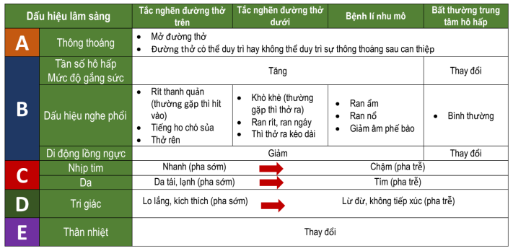
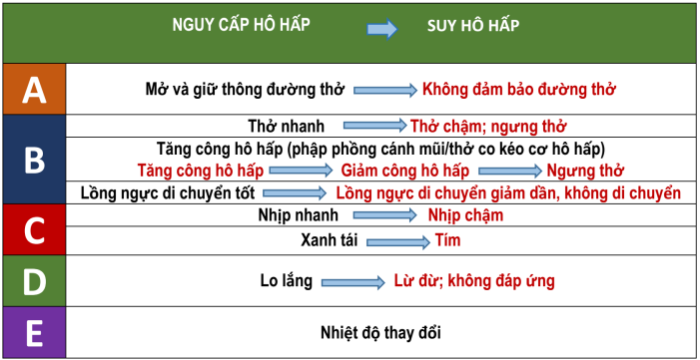

Slide 25
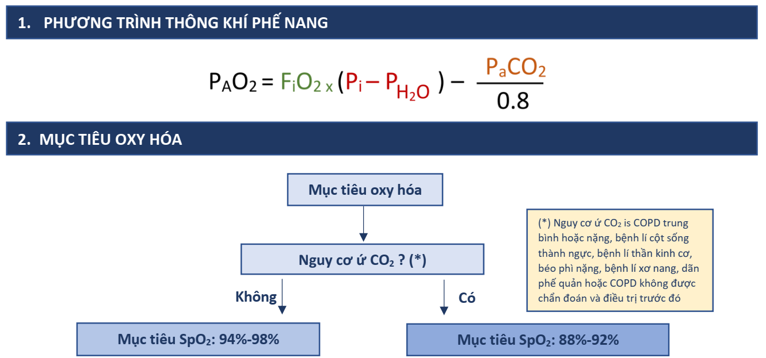

Slide 27
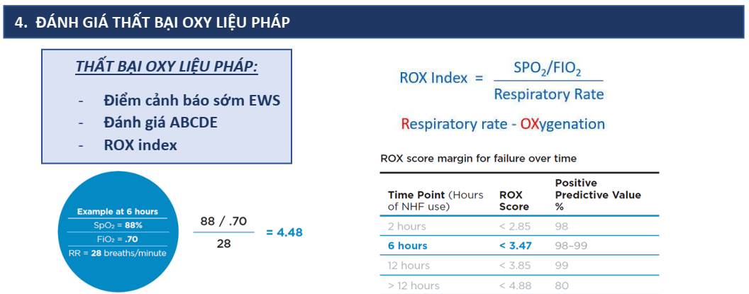

Slide 28
Indication Intubation

Slide 29
THANK YOU FOR YOUR ATTENTION

